Slide 1



Pseudepigrapha Detection using Neural Imposters
Capstone Project Phase A 23-1-R-21
Students
Asaf Davidovitch 314863945
Eliyahu Arnson 330319294
Supervisors
Dr. Renata Avros
Prof. Zeev Volkovich

Slide 2


Contents
Project Background
Project Target
Project Goals
Algorithm
Challenges & Issues

Slide 3
Project Background
Pseudepigrapha is falsely attributed works whose claimed author is not the true author.
Pseudepigrapha detection is a daily problem in many fields.
True authorship verification is an up-and-coming topic with increasing importance.

Slide 4
Pseudepigrapha Applications
Identifying unknown authorship & anonymous texts
Electronic texts, articles, social media posts
Copy Right detection of stolen works
Legal & Criminal Investigation

Slide 5
Project Goals
Research:
Understanding key components of the algorithm.
Comparing methods for the Embedding stage.
Learning the connections between the different components.

Slide 6
Project Goals
Project Book:
Building a project plan and phases.
Detailed description of the background concepts relating to the project.
Designing the diagram of the model in use.
Implementation:
Perform Post-Training on BERT model.
Implement a BERT transformer embedding model.

Slide 7
Project Target
The project target is on improving an existing algorithm of pseudepigrapha detection, more specifically improving the embedding stage.
The embedding stage is switched from Word2Vec embedding to a newer technique, BERT transformer.
The main benefit of this project is the application of the transformer methodology

Slide 8
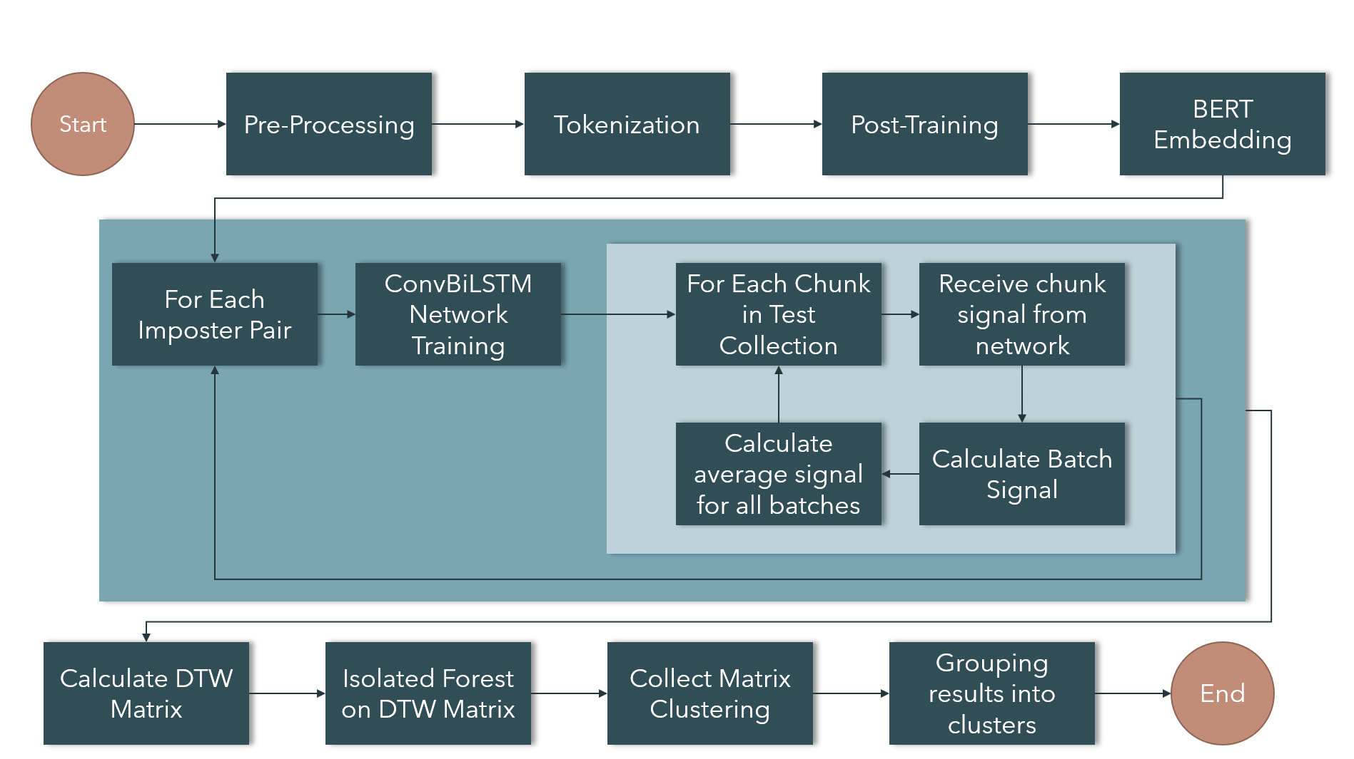
Solution

Slide 9
Algorithm
Pre-Processing
Tokenization
Post-Training
BERT Embedding
ConvBiLSTM
Calculating Batch Signals
DTW Matrix
Isolated Forest
Results Summarization

Slide 10
Pre-Processing & Tokenization
The purpose of Pre-Processing stage is to prepare the text for the model in order to receive quality and accurate results. Remove unwanted characters and lower case all the letters.
The purpose of Tokenization is to prepare the format of the text for the embedding model. Divide text into batches and chunks.
Each chunk is given a representing vector for the embedding model.

Slide 11
BERT Embedding
BERT, developed by Google, is an embedding model known for highly contextual understanding of texts.
The goal of embedding is to translate the text into a format that can be used in the neural network.
Each word is represented by a vector of values. This representation holds contextual understanding of each word and its relation to other words.

Slide 12
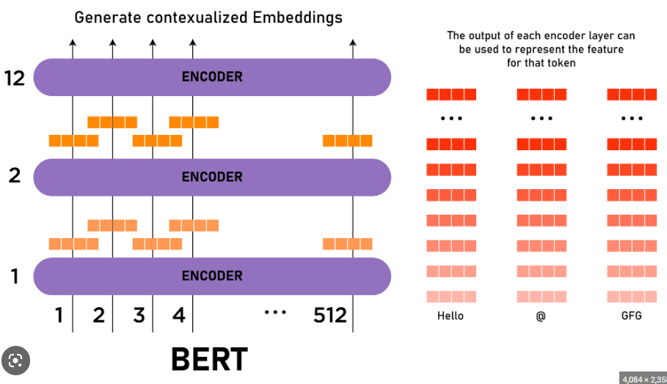

BERT Model

Slide 13
Post-Training
The BERT embedding model used in this project is a pre-trained transformer model.
Post-Training is the process of taking a pre-trained neural network and fine-tuning its weights to adjust for a specific task.
Our post-training is adding an additional layer to the pre-trained network and training it for 3 epochs.

Slide 14
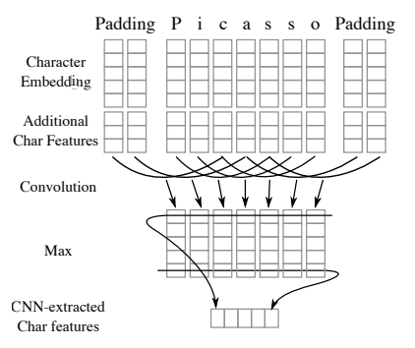
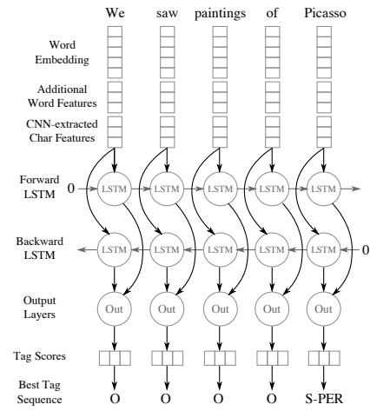
ConvBiLSTM
ConvBiLSTM is an algorithm built from two main components, CNN and Bidirectional-LSTM. The goal of the neural network is for classification.
CNN – Extracts character features from each chunk.
Bidirectional-LSTM – An LSTM model that works in both directions to calculate the signal value for each word chunk.

Slide 15
Calculating Batch Signals
Each chunk is inputted into the Convolutional Bidirectional LSTM and receives a value 0 or 1.
The average signal is calculated for all the chunks in a batch.
The values are saved in a matrix for the DTW stage.

Slide 16

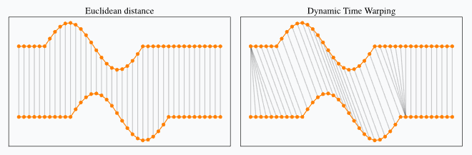
DTW Matrix
Dynamic Time Warping in short, DTW, is used to compare temporal sequences that are not synced up perfectly.
This method allows for capturing the optimal matching of sequences under comparison. DTW is used to calculate distances between two sequences.

Slide 17
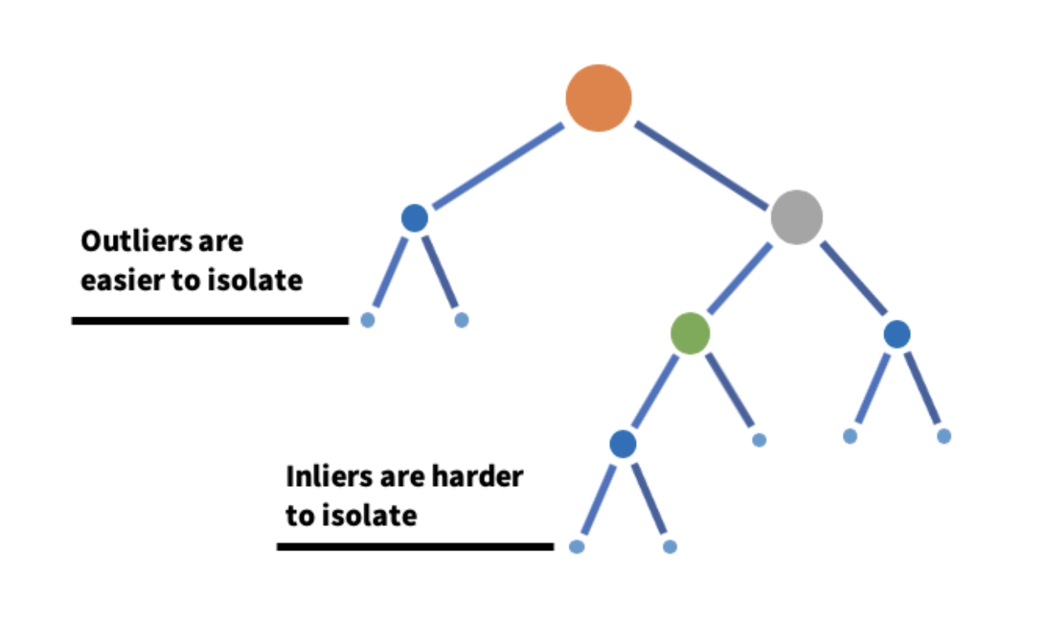
Isolated Forest
This process finds anomalies in given data set.
This algorithm is performed 1000 times on the DTW matrix.
The result of this stage clusters the data from the DTW matrix.

Slide 18
Project Challenges
Implementation – Finding compatible resources
Post-Training BERT – Research & testing
Verifying Correctness – Various unit tests & comparing results
Acquiring data sets – Find source of consistent and reliable data sets.

Slide 19
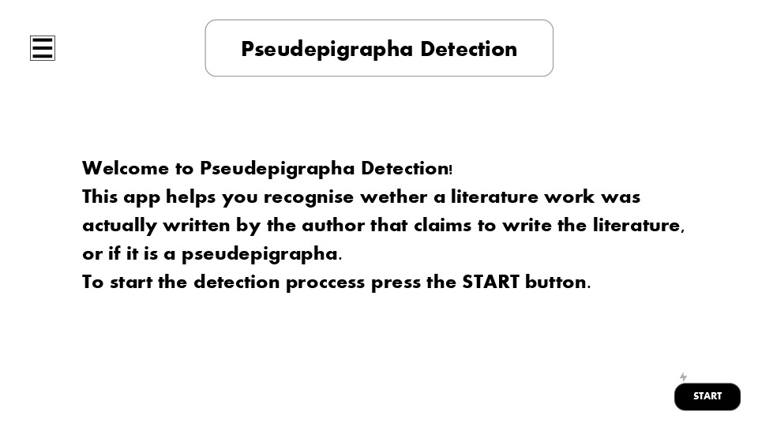
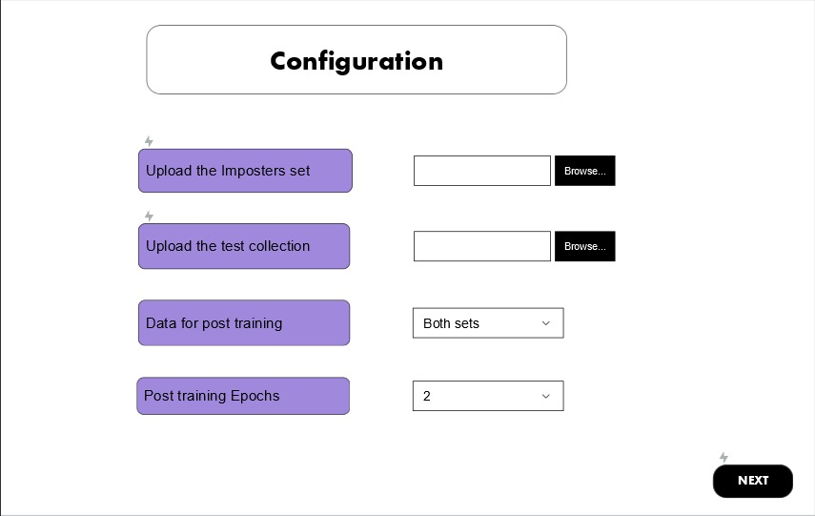
GUI

Slide 20
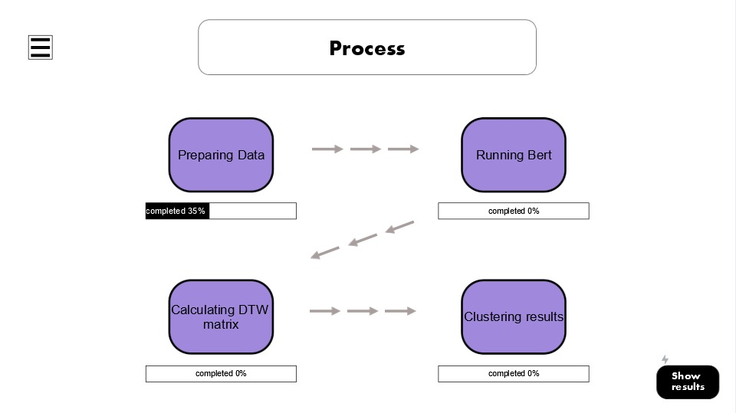
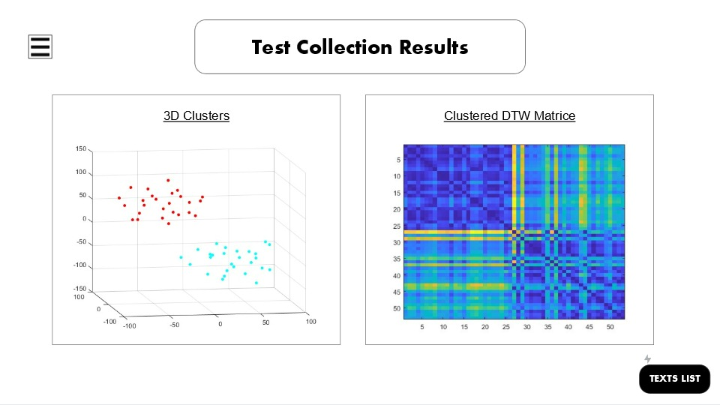
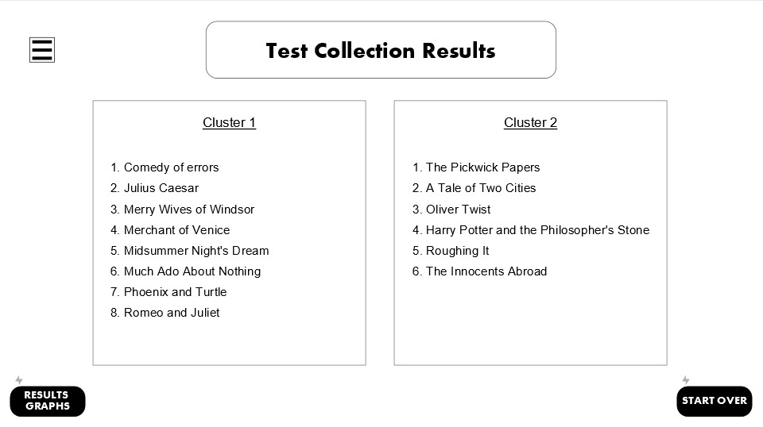
GUI

Slide 21

Thank You!

